Slide 1

Securely Access Secrets within Azure Key Vault
Overcoming the chicken-egg problem while accessing secrets from Azure VM
Kuala Lumpur, 14 March 2018
Notes:
Good evening guys,
Thank you for joining this session. Tonight, I am going to talk about secrets and Azure Key Vault.
Because my demo is quite long, I will just go through the slide quickly. Please let me know if you want me to repeat some particular slide.

Slide 2
Agenda
Secrets
Azure Key Vault
Accessing key vault
(DEMO) ARM VM Client certificate injection
(Preview) Azure Managed Service Identity
Notes:
So here is the agenda for this session.
I will briefly explain about what secrets and key vault is. And then we will encounter a problem while accessing the Key Vault and I will demonstrate one way to solve it. If time permits, I will also briefly explain about Managed Service Identity which is another way to solve the problem. So let‘s get started.

Slide 3
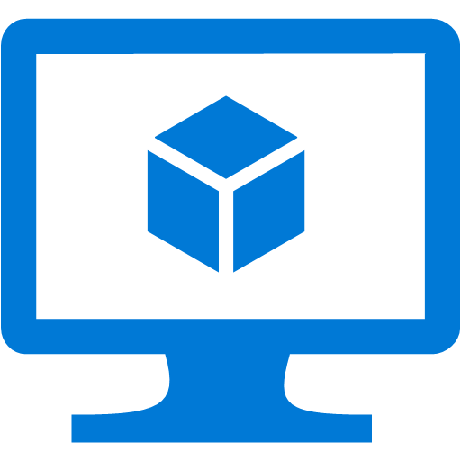

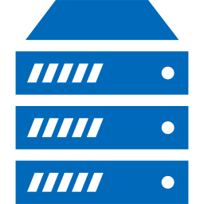
One challenge you can count on is…
Secrets
IaaS
Connection Strings
Certificates
Client Secret
SSH keys
Passwords
PaaS
Encryption keys
On-Prems
Notes:
These days there are so many ways on how you can run your apps.
You can run in virtual machines or you can host it in PaaS.
Regardless of how you build your apps, You can always find a common challenge, which is Secrets!
Things like connection strings to your database, passwords, encryption keys, or anything which is not supposed to be acquired without proper permissions.

Slide 4
One reason is the bad guys
Secrets
IaaS
Connection Strings
Certificates
Client Secret
SSH keys
Passwords
PaaS
Encryption keys
On-Prems
Notes:
And why is it a challenge? (click)
Because of the bad guys!
They are all over the place, looking for access to your sensitive data.
But that is not the only reason.

Slide 5
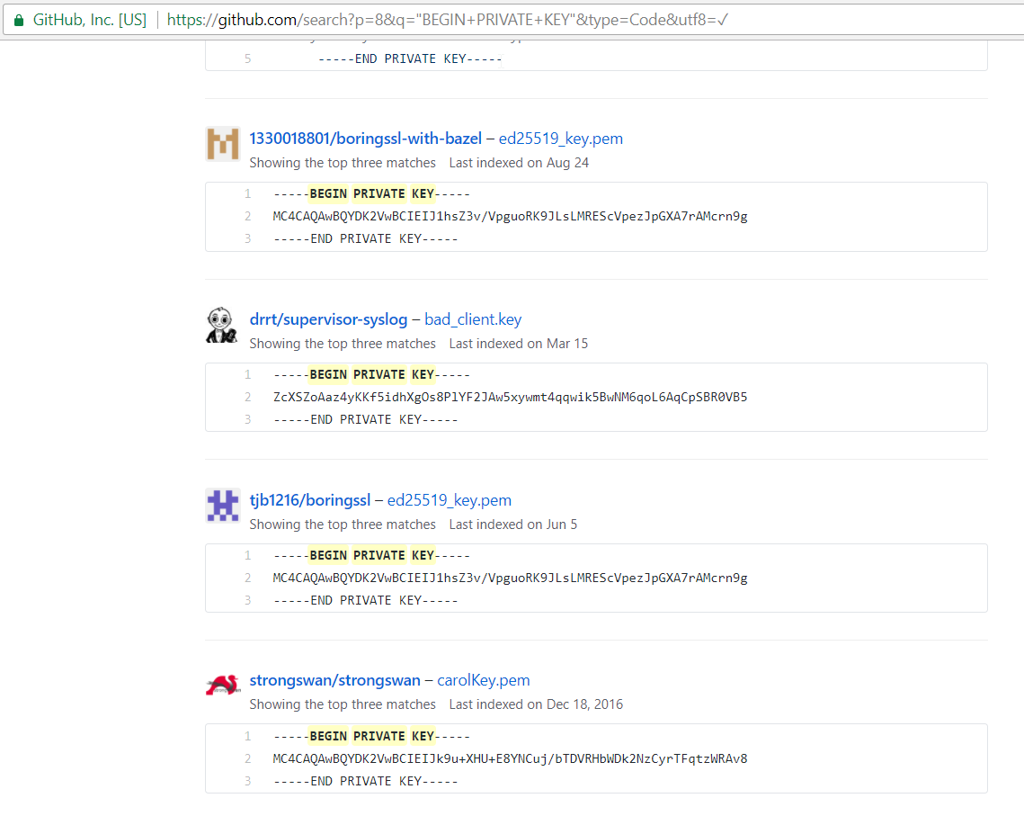
Another reason is negligence
Notes:
The other reason is our own silly mistakes.
The developers or any engineers who works with these secrets are human after all, and human makes mistakes.
You’ve probably heard a couple of data breaches are caused by human mistakes and these mistakes can cost companies a lot of money.
One of the common mistakes is putting the secrets publicly accessible.
Here is one example of public key publicly accessible on github.
Anyway, we are going to take a look at one tool that can help us in storing secret in Microsoft Azure.

Slide 6

Azure Key Vault
Secret Store as a Service
Store and manage secrets.
Isolate cryptographic keys.
Backed by HSMs
Highly Available
6 total copies in second region within same geo.
Service fails over automatically within region, or to secondary region.
Integrated with other Azure services / SDKs
Allows automated flows of secrets from source to destination
Connection Strings
Encryption keys
Client Secrets
Passwords
Azure Key Vault
Notes:
Azure Key Vault is a Managed Service that could help you store your secrets safely in Microsoft Azure. Just to make it simple, think of it as a Secret Store as a Service. All you have to do is just pay and use ☺

Slide 7
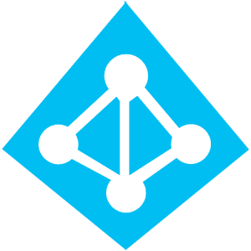
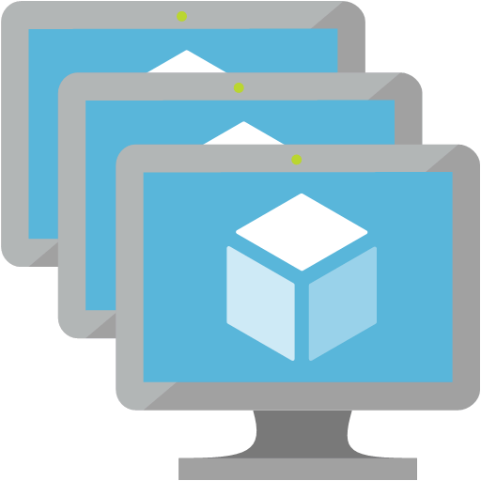
Accessing Key Vault
Azure Active Directory
Key Vault
Access Policies
Authenticate
Azure Key Vault
Access
Your App
Azure VM
Notes:
In order to access the Key Vault, applications must first authenticate to Azure Active Directory to get the access token.
And Azure Key Vault also have authorization in place with their access policies.
So in this diagram, the application have to authenticate and get the access token, and then it can use the access token to make a request azure key vault.
If the application identity is allowed in this policy, then it will be able to access it, otherwise no.

Slide 8

Accessing Key Vault
<?xml version="1.0" encoding="utf-8" ?>
<configuration>
<appSettings>
<add key=“ServicePrincipalId" value="clientid" />
<add key=“ServicePrincipalSecret" value=“clientsecret" />
</appSettings>
</configuration>
Azure Active Directory
Authenticate
Azure Key Vault
Access
Your App
Deploy
Azure VM
Developer
Notes:
Because the authentication is between machine-to-machine and it has to be automated, the application must submit a credential to Azure Active Directory.
And most of the example you’ve found use clientId and clientSecret and just store it in the application configuration.
Now we are securing secrets with another secret, so we need to find a way to secure this clientSecret too.

Slide 9
Accessing Key Vault
<?xml version="1.0" encoding="utf-8" ?>
<configuration>
<appSettings>
<add key=“ServicePrincipalId" value="clientid" />
<add key=“ServicePrincipalCertLocation" value="certlocation" />
</appSettings>
</configuration>
Azure Active Directory
Authenticate
Azure Key Vault
Access
Your App
Deploy
Developer
Certificate Store
Azure VM
Notes:
Luckily Azure Active Directory provides a way for us to authenticate using client certificate authentication.
In this case the clientSecret is no longer needed, but the applications now authenticate by proving that it owns the private key for the certificate.
The caveat in this approach is that the private key and its certificate must be installed in every machine that the applications used and it might be troublesome.

Slide 10
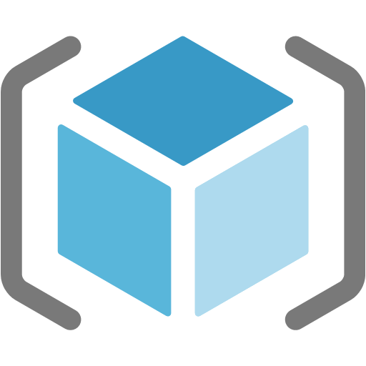
Demo – ARM VM Client Certificate Injection
Service Principal
Granted
Register
Private Cert
Secret Administrator
Azure Active Directory
Secret Identifier
Upload Cert
Azure Key Vault
ARM Template
Deploy
Azure Resource
Manager
Private Cert
Developer
Azure VM
Notes:
Luckily again, Azure provides us with a way to inject a certificate to Azure VM when it’s provisioned. I will demonstrate on how we can do it.
Before I begin, I would like to explain the current situation in this demo. Right now I already have an Azure subscription and an Azure Key Vault set up.
In the Key Vault I’ve stored two secrets, one is the password for the VM that we are going to deploy later, and the other one is the secret that the applications used, we call it super secret.
Point out the existing Key Vault and secrets.
In my machine, I have prepared self-signed certificates. Public is the certificate and private is the private key with the certificate.
Point out the existing self-signed certificates
Now the first step is, me as administrator need to create an Azure Service Principal for the VM. Think of Service Principal as an identity for the application. This Service Principal must be created using certificate instead of password. I have prepared a script in order to make it easier for me to create the service principal.
Point out to the New-AzureSPWithPublicCert.ps1
Basically the script will convert the public certificate into base64 string and we invoke the cmdlet to create a Service Principal.
- Execute the script.
After that, because we need Azure to inject the private key and certificate into the VM automatically, we need to upload the private key and the certificate into Key Vault. Practically we should use different Key Vault to restrict access to the private key, but in this case we will use existing Key Vault to make it easier.
I’ve also written a script to do it.
- Point out the Upload-PrivateCert.ps1
Basically we will convert the PFX file into base64, ask for its password, and then set it as a secret in Key Vault.
- Execute the script.
We then need to assign the Service Principal that we’ve created to be able to access super secret in Key Vault access policies.
Add new service principal in Key Vault access policies.
We are done as administrator. Now as developer, we can provision a new VM and let Azure inject the certificate automatically by providing the certificate location in the Key Vault.
I’ve prepared the ARM template to deploy a single VM, and we just need to modify the location of the certificate
Point out the ARM template and ARM template configuration.
Change the privateCertSecretId value from the uploaded certificate secret id.
And then we can deploy the VM
Deploy the VM
The deployment will take around 3 minutes or so. So I want to use the time to briefly explain Managed Service Identity.
- Go to the next slide.
So the deployment has been finished, now let’s just remote to our VM and try to get the super secret from there.
Remote to the VM
Check the certificate store using certlm.msc
We can see that our certificate has been injected. Now what I am going to do is to execute this script called Get-SuperSecret.
Point out the Get-SuperSecret.ps1
Basically, what the script does is calling Login-AzureRmAccount cmdlet using the certificate thumbprint and then get the value of the super secret.
Copy the Get-SuperSecret.ps1 into remote machine.
Open powershell window and execute Get-SuperSecret passing the tenantId and servicePrincipalId
Point out the super-secret value.

Slide 11
(Preview) Managed Service Identity
Service
Principal
Azure Resource Manager
Azure AD Tenant
Service that Supports Azure AD Authentication
Azure VM
Your App
http://localhost:50342/oauth2/token
MSI VM Extension
Notes:
I will not go into full details about this. But basically with MSI, you don’t have to do most of the steps that we’ve done just now.
When you enable MSI, Azure will automatically register a Service Principal for your VM and add a local endpoint to your VM for you to get the access token.
All you have to do now is to grant the Service Principal access to Key Vault, and then you can access it using the access token.

Slide 12
Thank you for your attention!
Contact: Hendry Anwar | Arvato Systems | hendry.anwar@bertelsmann.de
IT.arvato.com

